Slide 1

Rollins Game Review Forum
By:
Desmond Nieves
Stephan Zambrano
PJ González
Array & Back-end Implementation
Front-end Implementation
Archiving & Back-end Implementation
Notes:
Desmond worked on back-end arrayList formation & logic for the review forums & audience reviews.
Stephan works on GUI implementation on the front-end.
PJ worked on backend code (audienceReview, GameReviewForum & Driver) and ensured classes are properly coordinating with one another; Archived changes and group progress.
Remove update from last time & what next slides
Replace with Demo & How OOP is implemented slides, respectively

Slide 2
What Did We Want to Make?
Our original idea was a Video Game User Review System, that eventually grew into a Video Game Review Forum for Rollins students capable of the following:
Processing existing user review scores for video games onto a visual forum.
Output the overall average score for any given game.
  By extension: Categorize said scores into positive, mixed & negative ranges.
Prompt for the user to create a new review with.
  New review should then be added to the existing list of reviews and the overall average score for the game recalculated.
Notes:
• Slide 2: Brief description of your original concept and goals

Slide 3

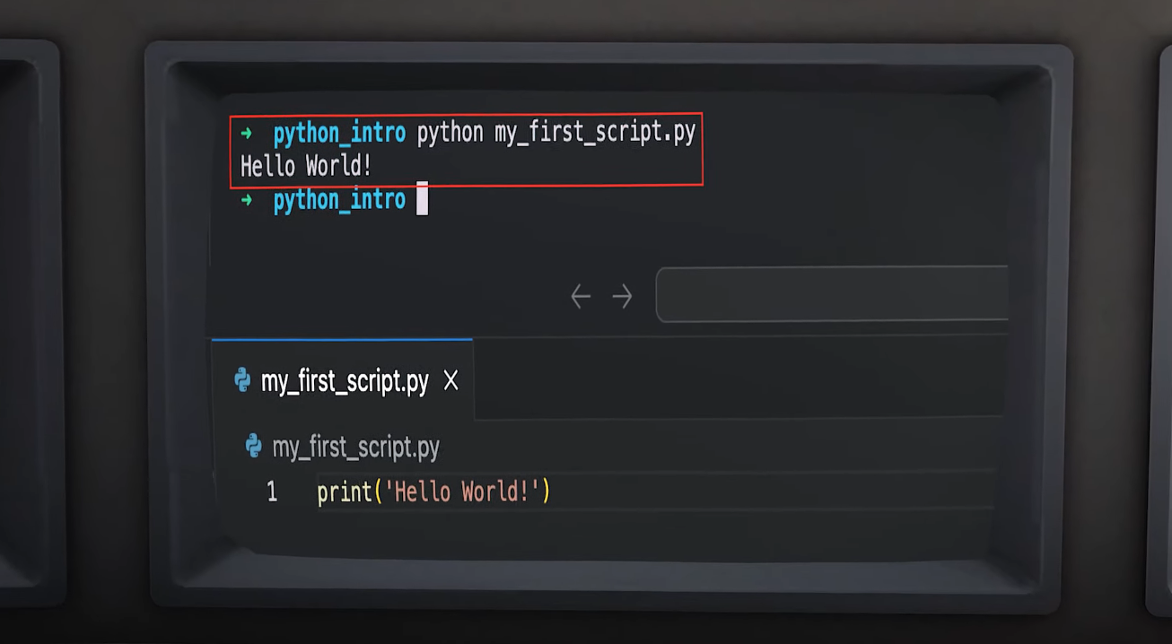
Demo Time
Pretend that’s java (and not python)
Notes:
• Slide 3: Demo the working features of your application.

Slide 4
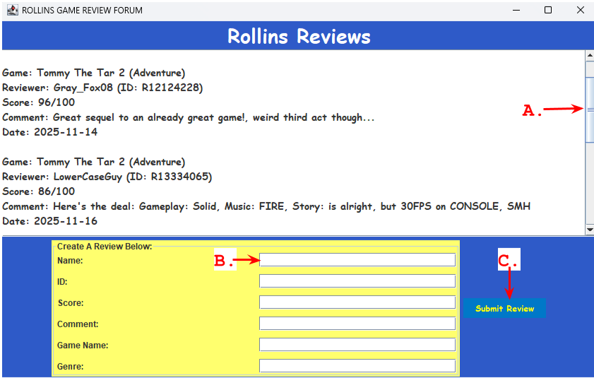
OOP Principles & Implementation
Abstraction:
AudienceReview & UserReview inherit protected fields from ReviewAbstract.
Encapsulation:
Back-end fields are given private access modifiers.
  Prevents unwanted access to data.
Event Driven Programming:
GameReviewForum & Driver implement event listeners & sources for the GUI.
  Scroll functionality
  Review generation
  User ‘Create a Review’ textboxes
  Buttons
= A.
= B.
= C.
Notes:
• Slide 4: Explain how OOP principles were implemented. (some screenshots be helpful)

Slide 5

What Did We Learn?
Communication is Key.
  “A chain is only as strong as its weakest link”
  - Sun Tzu in Spy Kids 3D (ca:2003 )
  As decent as our program turned out, we had a few significant hiccups throughout the project as a result of ineffective communication.
    Tldr: we worked on the same classes incidentally and ended up committing changes that undid the work of each other ~2 times.
  Thankfully, before thanksgiving break we agreed to spam our group chat as a heads up for each of us to prevent the same issue from occurring (it worked)
Hypothetically, how would we continue?
  Though the forum is functional, we were unable to implement a method
  to verify Student ID.
  The Rollins Video Game Forum would need to be revised to function
  within a browser’s web page.
Notes:
Remove update from last time & what next slides
Replace with Demo & How OOP is implemented slides, respectively

